Slide 1
Recap of Day 3
presentation
JSF is ____________ tier framework for developing ______ applications, which follow ______ design pattern.
In order to use JSTL in JSP, _______ element, _____ is required to be used, which has _____ and _______ attributes.
To display output on web browser _______ tag is used, to set attribute in a particular scope, ______ tag is used. Once attribute is removed using _________ tag, and we try to print it, what happens?
Conditional processing tags are ______ and _______.
<c:forEach> is __________ tag.
web
MVC
directive
taglib
uri
prefix
<c:out>
<c:set>
<c:remove>
<c:if>
<c:choose>
looping
Notes:
Goals JSF:
It addresses saving UI component state between requests on web client session
It provides a rendering mechanism for addressing variety of target web clients like, HTML, WML etc
It provides number of features for single page and multi-page processing of form-based requests
Along with form processing, it helps in form validation and necessary error reporting
It provides strongly typed component event model for responding client-generated events with server-side handlers
As web clients requests via HTTP provide, form data as Strings, so converting types for such data parameters is repeated task, and JSF provides facility to perform this, and necessary error reporting associated with it
It also provides z mechanism for handling errors (application error conditions) and reporting back to user interface
Multi-language support is also provided as it is key requirement for any web application

Slide 2
Session Plan – Day4
JSF Concepts overview
UI Component Model
Core tags in JSF
Managed Bean Facility
Event Handling
Page Navigation

Slide 3

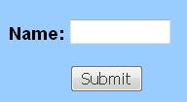

JSF Concepts Overview
displays
Renderer
View
selects
uses
generates
Event
Navigation
manipulates
OR
System
consumes
UI Component
updates
outcome
used by
Event Listener
returns
contains
executes
Backing Beans
Model Objects
Notes:
JSF Concepts Overview: Here we will be explaining how different systems in JSF Technology interact with each other. Specific details about each system is dealt in later slides.
Being a UI component framework, UI components occupy the center stage in JSF technology.
Each UI component has a renderer associated with it, which takes care of displaying the component to the client appropriately. JSF standard implementation comes with a HTML renderer kit which renders the UI components as HTML tags to the client(a web browser) (i.e. A view contains a set of UI components which are showed to the client using Renderer)
Each view is backed by a JavaBean class having properties holding the current state of the UI components contained in that view. This bean class is referred as backing bean. The backing bean properties are updated (synchronized) with the user entered data.
Apart from properties, the backing bean also contains methods to handle the events generated from the view. These methods are termed as Event Listener methods.
When UI components are manipulated by the user(like user clicking a button etc) , it may generate an event.
The generated event is consumed by the corresponding event listener.
The event listener can now perform different functionalities depending upon the event triggered
It manipulates the view as per the user action(e.g. disabling a button etc)
It executes model objects (java object having the business logic) and populate the model object results in a backing bean which is bound to the next view to be displayed.
Depending upon the execution of the model objects the Event Listener will return a logical outcome which is used by the Navigation System.
The Navigation System uses the navigation rules defined in the configuration file (faces-config.xml) to select the next view to be displayed to the user.
The UI components are rendered on to the view using renderer
Some Definitions:
UI Component: A stateful object, maintained on the server, that provides specific functionality for interacting with end users. UI components are JavaBeans with properties, methods, and events. They are organized into a view, which is a tree of components usually displayed as a page
Renderers: Renderers are responsible for displaying UI components and in translating user’s input into the respective component's value. Renderers are usually designed to work with one or more UI components, and a UI component can be associated with many different
Renderers.

Slide 4

UI Component Model
Education and Research
We enable you to leverage knowledge anytime, anywhere!
ER/CORP/CRS/ED113/003
Ver. No.: 1.0
Confidential
Copyright © 2008, Infosys Technologies Ltd.

Slide 5
Component Architecture of JSF
JSF provides a rich, flexible component architecture that includes following:
A set of UIComponent classes for specifying the state and behavior of UI components
A rendering model that defines how to render the components in various ways
An event and listener model that defines how to handle component events
A conversion model that defines how to register converters onto a component
A validation model that defines how to register validators onto a component

Slide 6
UI Component Basics
Each UI Component is implemented as UI component class in JSF
UI Component class may implement a behavioral interface which decides what actions and attributes can be used with the UI Component
For example
<h:inputText id=“username” valueChangeListener=“#{loginBean.changeID}” />
The <h:inputText> html tag is implemented as UIInput class in JSF. It implements EditableValueHolder interface which defines the behavior of this component. Since UIInput implements EditableValueHolder we can use valueChangeListener attribute with this tag.
Notes:
Few important UI component classes are listed below:
UICommand: Represents a control that fires actions when activated.
UIForm: Encapsulates a group of controls that submit data to the application. This component is analogous to the form tag in HTML.
UIOutput: Displays data output on a page.
UIInput: Takes data input from a user. This class is a subclass of UIOutput.
UIMessage: Displays a localized message.
UISelectItem: Represents a single item in a set of items.
UISelectItems: Represents an entire set of items.
UISelectMany: Allows a user to select multiple items from a group of items. This class is a subclass of UIInput.
UISelectOne: Allows a user to select one item from a group of items. This class is a subclass of UIInput.
For more information on UI Component classes and their associated behavioral interfaces please refer to JSF API.

Slide 7
UI Components
UI Components can be grouped into following kind of components:
Inputs: Tags for taking input from the user
Outputs: Tags for displaying output to the user
Commands: Tags for performing some action
Selections: Tags used for displaying options to the user Single or multiple values can be selected depending upon the tag used
Others: Tags such as forms, messages and components that lay out other components
Notes:
JSF HTML Tags can be categorized as below:
Inputs (tags starting with input.. )
Outputs (tags starting with output.. )
Commands (commandButton and commandLink)
Selections (checkbox, listbox, menu and radio. Tags starting with select..)
Others (form, panelGrid etc)

Slide 8
Common attributes of UI Component
Attribute | Description
id | Identifier for the component
rendered | A Boolean, if true, displays the component. Default is true
style | Specifies inline style for the component
styleClass | CSS style class name
value | A component’s value. It is not available with form, message and layout tags
required | A Boolean, if true, mandates a value to be entered for the component. Default is false. Available only with input tags and selection tags
Notes:
The attributes listed on the slide are available with all JSF HTML tags (UI Components) except for following:
value attribute cannot be used with tags defined in others category(refer previous slide) e.g. <h:form>, <h:message>
required attribute can be used only with inputs and selections

Slide 9
UI Component Rendering
JSF architecture defines the functionality of the components as a set of component classes and their rendering by a separate renderer
This facilitates:
Changing the appearance of components by selecting the appropriate combination of component and renderer for a client
Rendering the component to different clients (browser, cell phone, etc)
Notes:
Standard JSF implementation includes a standard HTML renderer kit for rendering components to an HTML client (browser)
Renderer Kit
The renderer kit defines the mapping between component classes and component tags appropriate for a particular client. It defines a set of Renderer classes for each component it supports. The Renderer class defines the way to output particular component. The standard JSF implementation includes a standard HTML render kit for rendering components to an HTML client.

Slide 10
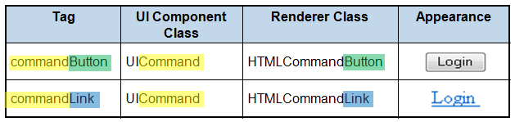
UI Component Rendering contd..
<h:commandButton id="login" value="Login" action="#{loginBean.authenticate}” />
<h:commandLink id="login" value=" Login " action="#{loginBean.authenticate}” />

Slide 11
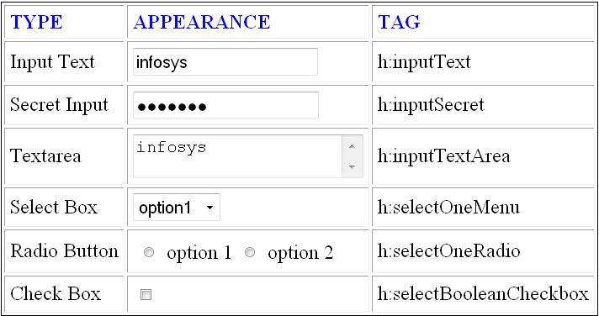
Appearance of few UI Components
TYPE | APPEARANCE | TAG

Slide 12
List of few JSF HTML tags
Tag | Description | Tag | Description
form | HTML form | selectOneMenu | Single-select menu
inputText | Single-line text input | selectOneRadio | Set of radio buttons
inputTextArea | Multiline text input | selectBooleanCheckBox | Single checkbox
inputSecret | Password input | selectManyCheckBox | Set of checkboxes
inputHidden | Hidden field | commandButton | Button: submit ,
outputLabel | Label for another component | commandLink | Link acts as button
outputLink | HTML anchor | panelGrid | HTML table
outputText | Single-line text output | message | Displays most recent message for a component

Slide 13
JSF Core Tag Library
Contains tags which helps in doing core tasks like validations, conversions, event handling
Some generic tags in the core tag library
f:view
f:selectItem
f:selectItems
<f:view>
Acts as a container for all JSF tags
One pair of <f:view> </f:view> tags, per JSP
Can contain other tags, template text, scriptlets
Notes:
Note:
1. validation and Conversion tags are covered later.
2. JSF Event Handling tags are not covered in this module. However, event handling is done using simple tag attributes (covered later).
<f:view>: Works as a Container for all JSF components. JSF implementation mandates all JSF components to be contained within this tag.

Slide 14
JSF Core Tags contd..
<f:selectItem>
Used as child component of JSF HTML tag library’s selectOne and selectMany family of tags.
Important attributes for this tag are:
attribute | Type | Description
value | SelectItem | Represents the components current value, can use value binding expression which should resolve to SelectItem object)
itemLabel | String | Name of the item which is rendered as <option> element’s label, when the tag is enclosed by html select family tags.
itemValue | Object | The value of the item which is rendered as value of the <option> element, when the tag is enclosed by html select family tags.
Notes:
<f:selectItem>: Used as a child component of JSF HTML tag libray’s selectOne and selectMany family of tags like h:selectOneMenu, h:selectManyMenu, h:selectOneRadio, h:selectListbox etc.,
Using this tag alone does not display anything on the browser, but the tag attribute’s value will be used by its enclosed parent tag to in turn render the <option> elements.
The SelectItem is a java class, present in javax.faces.model package. It used to represent a single item having value and label properties to be used by the parent tag for rendering <option> elements.
If the value attribute is used itemLabel and itemValue are not used. However if value-binding expression is used for the value attribute and if the bean referenced by the value-binding expression is not found itemLabel and itemValue will be used to serve as default value.
usage:
<f:selectItem itemValue=“delhi" itemLabel=“Delhi"/>
<f:selectItem value="#{selectCity}" itemValue=“mys“ itemLabel=“Mysore"/>
<f:selectItem value="#{selectCity}"/>
where, selectCity is an of type javax.faces.model.SelectItem class.
Note: A combination of above (hard-coded and using value attribute) can be nested inside the same selectOne and selectMany tag family.
<h:selectOneMenu>
<f:selectItem itemValue=“delhi" itemLabel=“Delhi"/>
<f:selectItem value="#{selectCity}" itemValue=“mys“ itemLabel=“Mysore"/>
<f:selectItem value="#{selectCity1}"/>
</h:selectOneMenu>

Slide 15
JSF core Tags contd..
<f:selectItems>
Used as child component of JSF HTML tag library’s selectOne and selectMany family of tags.
Used to display a collection of items using the tag’s value attribute.
<f:selectItems value="#{bean.selectCities}"/>
Renders a group of <option> elements when nested inside the parent tag.
Notes:
<f:SelectItems>
Only value attribute can be used with this tag, in contrast to itemLabel, itemValue and value in <f:selectItem>
The tag’s value attribute’s value binding expression can be any collection object like list/array of type SelectItem or a map object.
e.g. <f:selectItems value="#{bean.selectCities}"/>
Where, selectCities is a bean property which is a list/array of type SelectItem or a map object.
Both selectItem and selectItems can be nested inside the same parent tag.

Slide 16
Do you know??
What is a component tree and what information does it contain?
A tree of JSF UI components defined on each page (inside <f:view></f:view> tag). It holds the state (user input) information for each UI component.
How does JSF change the appearance of UI components having same functionality?
Using a different renderer
Can JSF be used for mobile devices?
Yes, using a renderer kit specific to mobile devices

Slide 17
Managed Bean Facility
Provides facility to:
Declare and initialize beans in a central place (faces-config.xml)
Control the scope (application, session, request or none) where a bean is stored
Change a bean’s class or initial values without any changes to the code (only a change in the configuration file is necessary)
Initialize bean properties with value-binding expressions
Access a managed bean using ordinary JSF EL expressions
Notes:
Scopes :(none, request, session ,application)

Slide 18
Declaring a Managed Bean
Any public Java class with a default (no-argument) constructor can be declared as a managed bean. To declare the bean as a managed bean we need:
A name that will be used as an identifier
The class name and,
The scope in which the bean should be stored
The Managed bean is configured in faces-config.xml using <managed-bean> element as shown below.
<managed-bean>
<managed-bean-name>loginBean</managed-bean-name>
<managed-bean-class>com.infy.LoginBean</managed-bean-class>
<managed-bean-scope>session</managed-bean-scope>
</managed-bean>
Notes:
Declaring a Managed Bean:
Any public Java class with a default(no-argument) constructor can be declared as a managed bean.
The Managed bean is configured in faces-config.xml using <managed-bean> element as shown on the slide.
To declare the bean as a managed bean we need:
A name that will be used as an identifier
The class name and
The scope in which the bean should be stored
The three pieces of information listed above translate into the <managed-bean-name>,<managed-bean-class>, and <managed-bean-scope> elements nested in the <managed-bean> element as shown below.
<managed-bean>
<managed-bean-name>loginBean</managed-bean-name>
<managed-bean-class>com.infy.LoginBean</managed-bean-class>
<managed-bean-scope>session</managed-bean-scope>
</managed-bean>
The above configuration stores the LoginBean in session scope and makes it available to JSF EL as loginBean.
The “loginBean” String used in the <managed-bean-name> element is nothing but the object’s name, like
LoginBean loginBean = new LoginBean(); This name will be used in value-binding and method-binding expressions to reference the bean’s properties and listener methods.
When loginBean is first referenced from the jsp page (view), the JavaServer Faces implementation instantiates it and initializes it’s bean properties, if any, declared in the configuration file. The bean is then stored in the session scope if no earlier instance exists.

Slide 19
Initializing Bean properties(1/2)
Bean properties can be initialized to default values using the Managed Bean Facility as shown below
<managed-bean>
<managed-bean-name>loginBean</managed-bean-name>
<managed-bean-class>com.infy.LoginBean</managed-bean- class>
<managed-bean-scope>session</managed-bean-scope>
<managed-property>
<property-class>java.lang.Integer</property-class>
<property-name> loginId </property-name>
<value>1234</value>
</managed-property>
</managed-bean>
Notes:
Initializing Bean properties
JavaBean properties(ones with both a getter and a setter method) can be initialized using managed bean facility. Any properties that aren’t explicitly initialized will get either the default values or the one’s given in the bean’s default constructor.
The managed Bean’s properties can be initialized using <managed-property> element, nested inside a <managed-bean> element.
To initialize a property we need to have at a minimum <propertyname> and<value> element nested in the <managed-property> element.
The value is specified with either the <value> element or <null-value> element. The value can either be null, a literal string, or a value-binding expression.
Note: <property-class> element is optional, which can be used to specify the property’s Java class or its primitive type. The Managed Bean Creation facility usually doesn’t need this element as it can figure out the property’s type on its own.

Slide 20
Initializing Bean properties(2/2)
A managed bean can initialize its bean properties to refer to other managed beans/implicit objects using value binding expression
<managed-bean>
<managed-bean-name>locker</managed-bean-name>
<managed-bean-class>com.infy.Locker</managed-bean-class>
<managed-bean-scope>session</managed-bean-scope>
</managed-bean>
<managed-bean>
<managed-bean-name>account</managed-bean-name>
<managed-bean-class>com.infy.Account</managed-bean-class>
<managed-bean-scope>session</managed-bean-scope>
<managed-property>
<property-name>locker</property-name>
<value>#{locker}</value>
</managed-property></managed-bean>
Notes:
Referring to other managed beans:
Locker.java
public class Locker {
private int lockerNo;
//other data members and getters/setters
}
Account.java
public class Account {
private int accNo;
private Locker locker;
//other data members and getters/setters
}
A managed bean can refer to other managed beans to initialize it’s properties. In the slide above account bean has a property locker of type com.infy.Locker, this property can be initialized using a value-binding-expression, “#{locker}” as shown on the slide.
Note: Only beans with scope equal to or wider than what the referring bean is declared can be referenced. However, there is one exception to this rule, a bean with scope “none” can be referenced from any bean to initialize it’s properties.
In the slide, since the locker bean will be stored in session scope upon its creation we can reference it from the account bean as the account bean is also in session scope. However if the locker bean was declared to be stored in request scope, it can not be referenced from account bean.
On the other hand if the locker bean is not stored i.e, declared as <managed-bean-scope>none</managed-bean-scope> the locker object will be created when referenced from account bean.
If we refer to the locker object directly in the JSP using value-binding expression, then each time the locker object is referenced a new locker object instance will be created as the bean is not stored in any scope.

Slide 21
Declaring and Initializing Lists, and Maps as managed objects
Declaring and initializing a List object as a managed Bean
<managed-bean>
<managed-bean-name>mailingAddress</managed-bean-name>
<managed-bean-class>java.util.ArrayList</managed-bean-class>
<managed-bean-scope>application</managed-bean-scope>
<list-entries>
<value-class>java.lang.String</value-class>
<value>feedback@infosys.com</value>
</list-entries>
</managed-bean>
Notes:
Declaring Lists and Maps as managed Objects
Only concrete implementation classes like java.util.ArrayList, can be specified with the <managed-bean-class> element while declaring List/Map as managed object.
Declaring and initializing a Map object as managed object:
<managed-bean>
<managed-bean-name>InfyWeb</managed-bean-name>
<managed-bean-class>java.util.HashMap</managed-bean-class>
<managed-bean-scope>application</managed-bean-scope>
<map-entries>
<map-entry>
<key>Infosys official website</key>
<value>http://www.infosys.com</value>
</map-entry>
<map-entry>
<key>Infosys Intranet</key>
<value>http://sparsh</value>
</map-entry>
<map-entries>
</managed-bean>
Note: Map keys can not be null, values can be null(<null-value/>). JSF doesn’t support using Arrays as individual managed objects.

Slide 22
Do you know??
Can any collection be added as managed beans?
No, only concrete collection class implementations can be added, for e.g. we can’t have managed bean of List type
How can we specify default values to properties of a managed bean object?
By hard coding default value in <value> tag within the <managed-property> tag of faces-config.xml
Can a managed property get its value from managed bean in other scope?
Yes, but the scope of the referred bean should be wider

Slide 23
JSF Event Handling Model
UI Components can emit some kind of signals based on user actions (a button click or radio button selection). These signals are termed as Events.
Application defines handlers to handle the generated events on the server side using event handlers.
Event handlers usually are methods(with specific signatures) defined in Backing Beans or in a separate class.
These event handling methods are tied to UI components using method binding expressions
Notes:
Note: JSF Event handling model is based on Java Beans Event Handling model
Event Handling Techniques:
Generally event listeners(event handling methods) are implemented as backing bean methods which usually suffices in most of the cases. However it can also be implemented as a separate class if it has some reusability value.

Slide 24
Event Types
JSF components can generate 4 types of Events
Action Events
Value Change Events
Data Model Events and
Phase Events
Only Action Events and Value Change Events are covered in this module

Slide 25
Action Events
Triggered when the user interacts with components like
<h:commandButton value="…"/>
<h:commandButton image="..." />
<h:commandLink .../>
Are handled by action listener methods
These cause the form to be submitted automatically
Notes:
Note:
Only components that implement ActionSource/ActionSource2 behavioral interface can generate Action Events.
So we can use “action” and “actionListener” attributes only with tags that represent the components implementing ActionSource/ActionSource2 (for e.g. commandButton and commandLink).

Slide 26
Action Listener Types
That decides application's navigation
Referenced from action attribute of the component tag
The handler method returns a String and does not accept any parameter
That manipulates UI components on the current view
Referenced from actionListener attribute of the component tag
The handler method accepts ActionEvent as the parameter and returns nothing
Notes:
Action Listeners /methods are of two types
1.That decide application’s navigation, these methods are referenced from action attribute of the component tag.
The action handlers defined in the backing beans have a signature:
public String methodName(){….return “success”;}
Refer to the login example discussed earlier for details about using action method.
2. That manipulates UI components on the current view (The view from which the request was sent)
ActionEvent is present in the package javax.faces.event
ActionEvent has a getComponent method that lets us to obtain the UIComponent reference.
From the UIComponent, we can get the id of the component, renderer, and other low-level information.
UI component manipulation demo using actionlistener is not covered in this course.

Slide 27
Value Change Event
Fired by components like
<h:inputText .../>
<h:selectOneMenu .../>
Referenced from valueChangeListener attribute of the component tag
The value change event handler takes ValueChangeEvent as method argument
Does not cause the form to be submitted automatically (should use javascript)
Let us see how to use ValueChangEvent to implement the balance enquiry functionality of the banking application
Notes:
Value Change Events can be fired by UI components which are editable, like combo boxes, checkboxes, radio buttons, text boxes, drop-down lists etc.,.

Slide 28
Creating backing bean
package com.infy.enr;
import java.util.ArrayList;
import java.util.List;
import javax.faces.event.ValueChangeEvent;
import javax.faces.model.SelectItem;
public class AccountBean {
private List<SelectItem> accountNoList;
private Integer accountNo;
private Double balance;
public AccountBean(){
accountNoList = new ArrayList<SelectItem>();
accountNoList.add(new SelectItem("101","101"));
accountNoList.add(new SelectItem("102","102"));
accountNoList.add(new SelectItem("103","103"));
}
/* getter and setter methods for data members */
public void getAccountBalance( ValueChangeEvent event)
{
Integer accNo= (Integer)event.getNewValue();
if(accNo ==101){
balance=20000.00;}
else if(accNo==102){
balance=15000.00;}
else if(accNo ==103){
balance=25000.00;}
else {
balance=0.0;
}
}
}
AccountBean.java

Slide 29
Adding managed bean declaration
<faces-config >
<managed-bean>
<managed-bean-name>
accountBean
</managed-bean-name>
<managed-bean-class>
com.infy.enr.AccountBean
</managed-bean-class>
<managed-bean-scope>
request
</managed-bean-scope>
</managed-bean>
</faces-config>
faces-config.xml

Slide 30
Creating the JSP page
<%-- add the taglib declarations --%>
<html>
<head>
<script language="javascript">
function fnsubmit() {
document. forms[0].submit();
}
</script></head>
<body>
<f:view>
<h:form id="balanceEnquiryForm">
<h:outputText value="Account No: “/>
<h:selectOneMenu value="#{accountBean.accountNo}” valueChangeListener=
"#{accountBean.getAccountBalance}" onchange="fnsubmit()” >
<f:selectItem itemLabel=“Acc” itemValue="0” />
<f:selectItems value="#{accountBean.
accountNoList}" id="Items” />
</h:selectOneMenu>
<br />
<c:if test=
"${accountBean.balance > 0.0}” >
<h:outputText value="Your Balance is: #{accountBean.balance}” />
</c:if>
</h:form>
</f:view></body></html>
balanceEnquiry.jsp

Slide 31
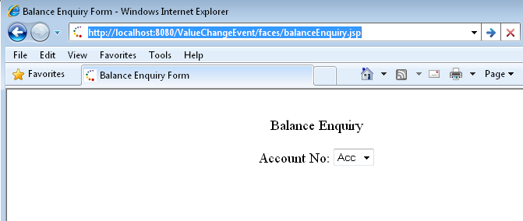
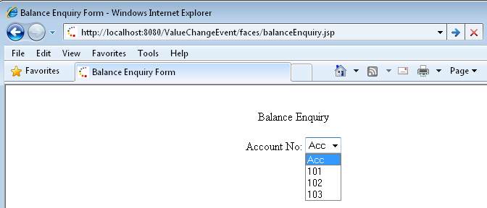
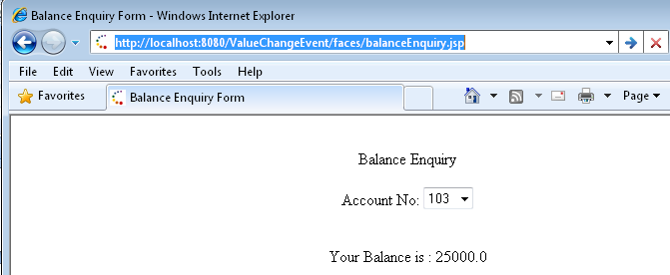
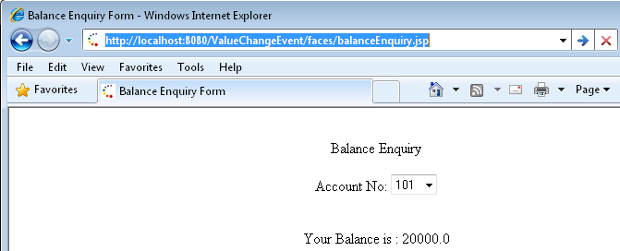
Upon changing the value in select box same page is displayed with new balance
Let us see the output

Slide 32
Do you know??
Should Event Handlers be defined only in backing beans?
No, event handler could also be implemented as separate class
Attributes used for triggering an action event are-
action and actionListener. These are available only with commandButton and commandLink UI Components
Can value change event be fired by any UI Component?
No, it can be fired only by editable components. Editable components include all inputs and selections

Slide 33
Page Navigation
A set of rules for choosing the next page to be displayed after a button or hyperlink is clicked
To handle navigation
The rules must be defined in the application configuration file
The action attribute of the button or hyperlink must refer to the outcome string
JSF uses this outcome string to select the page to be displayed

Slide 34
Static and Dynamic Navigation
Navigation can be static or dynamic based on how the outcome string is referred by the action attribute
In static navigation, clicking on the button or hyperlink, always selects a fixed page for rendering the response
Whereas, in dynamic navigation, the page rendered is determined by a business logic
A method returning string implements the business logic
The action attribute refers to this method and based on the return value, the page to be displayed is selected

Slide 35
Static Navigation: Example 1
Login.jsp
success
Welcome.jsp

Slide 36
JSP Code
<h:commandButton value="Login" action=“success">
</h:commandButton>

Slide 37
Defining navigation rules
<navigation-rule>
<display-name>login</display-name>
<from-view-id>/Login.jsp</from-view-id>
<navigation-case>
<from-outcome>success</from-outcome>
<to-view-id>/Welcome.jsp</to-view-id>
</navigation-case>
</navigation-rule>

Slide 38
Static Navigation: Example 2
Welcome.jsp
success
Login.jsp
signup
Signup.jsp

Slide 39
JSP Code
<h:commandButton value="Login" action=“success">
</h:commandButton>
<h:commandLink action="signup">
<h:outputText value="Sign up"></h:outputText>
</h:commandLink>

Slide 40
Defining navigation rules
<navigation-rule>
<display-name>login</display-name>
<from-view-id>/Login.jsp</from-view-id>
<navigation-case>
<from-outcome>success</from-outcome>
<to-view-id>/Welcome.jsp</to-view-id>
</navigation-case>
<navigation-case>
<from-outcome>signup</from-outcome>
<to-view-id>/Signup.jsp</to-view-id>
</navigation-case>
</navigation-rule>

Slide 41
Dynamic Navigation
<h:commandButton value="Login” action="#{loginBean.navigate}">
</h:commandButton>

Slide 42
Writing a method which determines the navigation
public String navigate(){
if(this.password.equals("infy")){
return "success";
}else{
return "failure";
}
}
Notes:
Method called in the action attribute should always return String value.

Slide 43
Defining navigation rules
<navigation-rule>
<display-name>login</display-name>
<from-view-id>/Login.jsp</from-view-id>
<navigation-case>
<from-outcome>success</from-outcome>
<to-view-id>/Welcome.jsp</to-view-id>
</navigation-case>
<navigation-case>
<from-outcome>failure</from-outcome>
<to-view-id>/Failure.jsp</to-view-id>
</navigation-case>
</navigation-rule>

Slide 44
Dynamic navigation
Login.java
Welcome.jsp
loginBean.navigate()
success
Login.jsp
failure
Failure.jsp

Slide 45
Summary
UIComponent model provides exhaustive set of component classes, for accepting, displaying data to user, which are supported by various renderers, and fire events
JSF provides core tags, such as <f:view> </f:view> which is MUST tag in every JSP and represents root of UIComponent tree created for that JSP
Managed Bean Facility provides way to declare, initialize and manage backing beans in web application externally (through faces-config.xml)

Slide 46
Summary
Page navigation is defined externally in the configuration file, faces-config.xml, with <navigation-rule> tag
Normally, the navigation is decided upon the outcome of event handlers, which typically is String
So various types of events are fired by various UI components, and event handlers are written which define the actions to be taken in case of that event happening

